Slide 1


KONGU ENGINEERING COLLEGE
An Intelligent IoT-Based Pressure Monitoring System for Spinal Orthosis
DOMAIN : EMBEDDED SYSTEMS
GOBINATH P (23ECR062)
HARIHARAN K C (23ECR069)
KAVIYARASU A (23ECR105)
KIRUBAGARAN A (23ECR110)
Guided by - Dr P Sivaranjani
Professor,ECE,Kongu Engineering College
23-06-2026

Slide 2
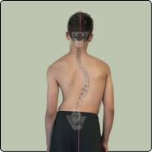
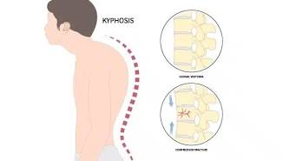
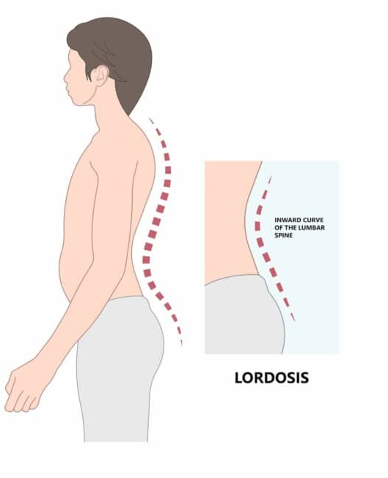
INTRODUCTION
What are Spinal Disorders?
Spinal disorders are conditions that affect the normal alignment of the spine, leading to pain, poor posture, and reduced mobility.
Common Types
Scoliosis – Sideways curvature of the spine
Kyphosis – Excessive outward curvature (hunchback)
Lordosis – Excessive inward curvature of the lower back
Challenges
Persistent back pain
Poor posture and imbalance
Difficulty in daily activities
Progression of spinal deformities if left untreated
scoliosis
Kyphosis
Lordosis

Slide 3
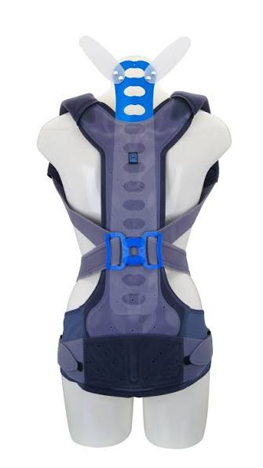
EXISTING SOLUTION
What is a Spinal Orthosis?
A spinal orthosis (back brace) is a medical device used to support and correct abnormal spinal curvature by applying controlled pressure to specific areas of the spine.
Current Treatment Method
Orthosis is custom-fitted for each patient.
Clinicians manually adjust the brace based on patient feedback and experience.
Patients wear the brace for several hours each day to gradually improve spinal alignment.
Limitation
Current braces cannot continuously measure the applied pressure, making it difficult to ensure the correct corrective force, which may lead to discomfort, poor fitting, and reduced treatment effectiveness.
Spinal Orthosis

Slide 4
Literature Survey
S.No | Title | Author(s) | Journal / Conference | Year | Remarks
1 | Pressure Sensor System for Customized Scoliosis Braces | M. M. Fuss, et al. | Sensors (MDPI) | 2021 | Base paper. Introduces a pressure sensor system for spinal braces. this work extends it with AI, IoT, and real-time monitoring.
2 | Applied Research on Pressure Distribution Detection Technology of Spinal Orthosis | Y. Zhang et al. | IEEE International Conference | 2023 | Proposes pressure distribution measurement in spinal orthoses. Used as the primary IEEE reference.
3 | A Wearable Sensor Array for Real-Time Spine Posture Monitoring During Exercise | J. Kim et al. | IEEE Transactions on Biomedical Engineering | 2023 | Demonstrates wearable sensing for spine posture monitoring; supports sensor placement and wearable design.
4 | Integrated Pressure Sensor and sEMG Array for Scoliosis Monitoring | H. Liu et al. | IEEE Conference Proceedings | 2024 | Combines pressure sensing with physiological monitoring. Inspires future expansion of the proposed system.
5 | Flexible Wearable Sensors for Spinal Orthosis Monitoring: A Review | S. Wang et al. | IEEE Access | 2025 | Reviews recent wearable sensor technologies and highlights research gaps addressed by Spinobar.

Slide 5
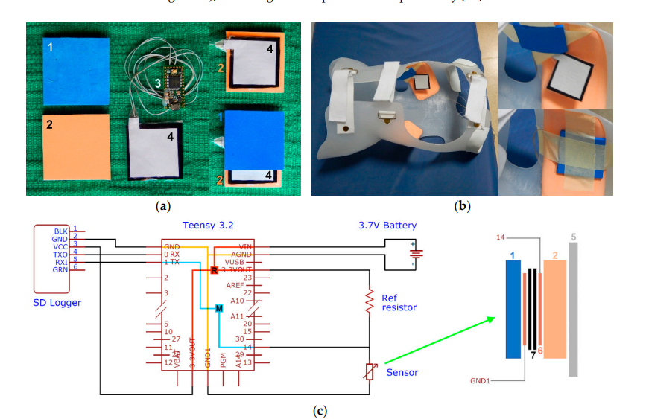
Base Paper
Pressure Sensor System for Customized Scoliosis Braces Sensors (MDPI), 2021
Existing Approach
Flexible piezoresistive pressure sensors are embedded inside a scoliosis brace
Measures the pressure applied between the brace and the patient's body
Provides real-time pressure readings during brace usage
Helps clinicians evaluate whether the corrective force is within the desired range
Limitations
No Artificial Intelligence for pressure analysis
No prediction of improper brace fitting
No wireless/mobile application support
No patient history or long-term monitoring
Limited assistance for clinicians in decision-making
Reference image from base paper

Slide 6
SCOLIOSIS
What is Scoliosis?
A condition in which the spine curves sideways into a 'C' or 'S' shape
Most commonly occurs in adolescents between 10–18 years of age
If left untreated, the spinal curvature may worsen over time, causing pain, poor posture, and breathing difficulties
Current Treatment:
Thoraco-Lumbo-Sacral Orthosis (TLSO), commonly known as the Boston Brace, is widely used.
The brace applies corrective pressure to specific regions of the spine.
Patients are typically required to wear the brace for 16–23 hours per day.
Project Focus:
Develop an AI-assisted smart pressure monitoring system for scoliosis braces to improve brace fitting, patient comfort, and rehabilitation outcomes.

Slide 7
Solution
Spinobar:
An intelligent spinal orthosis pressure monitoring system that enhances the existing pressure sensing approach using AI and IoT technologies
Proposed Features:
Real-time pressure monitoring using flexible sensor array
Bluetooth-enabled communication with a mobile application
AI-based prediction of improper brace fitting
Pressure heatmap for easy visualization
Personalized brace adjustment recommendations
Cloud-based patient history and rehabilitation tracking
Advantages:
Improves fitting accuracy
Enhances patient comfort and safety
Assists clinicians in making faster decisions
Low-cost, portable, and suitable for routine clinical use

Slide 8
AI Models Proposed
1D Convolutional Neural Network (1D-CNN):
Processes pressure sensor data from the spinal orthosis
Automatically extracts important pressure distribution features
Detects high-pressure and low-pressure regions
Reduces noise and improves feature quality
Long Short-Term Memory (LSTM)
Analyzes pressure data over time
Learns pressure variations during sitting, standing, walking, and movement
Identifies abnormal pressure changes and posture-related patterns

Slide 9
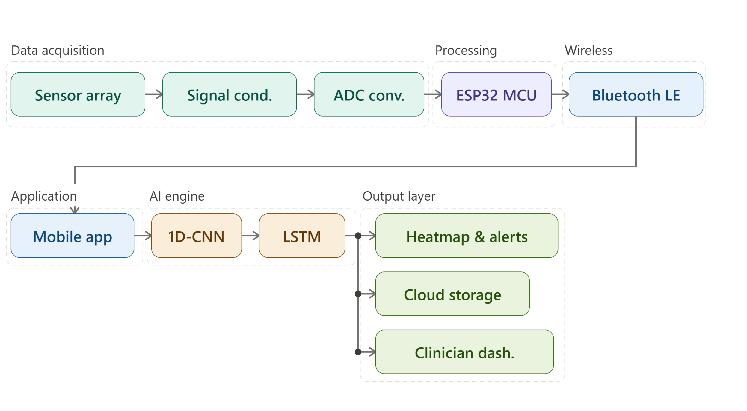
Block Diagram
9

Slide 10
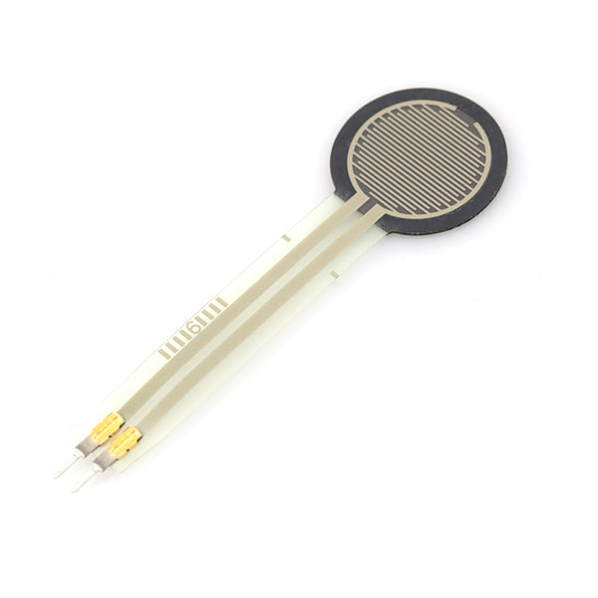


Hardware and Software
Hardware:
Pressure Sensor(FSR/Velostat)
ESP32
Spinal Orthosis (Brace)
Software:
Python
TensorFlow
Numpy and Pandas
Scikit learn
FSR sensor
Spinal Orthosis
Python
TensorFlow

Slide 11
Reference
[1] F. K. Fuss, A. Ahmad, A. M. Tan, R. Razman, and Y. Weizman, "Pressure Sensor System for Customized Scoliosis Braces," Sensors, vol. 21, no. 4, Art. no. 1153, 2021.
[2] J. Kim et al., "A Wearable Sensor Array for Real-Time Spine Posture Monitoring During Exercise," IEEE Transactions on Biomedical Engineering, 2023.
[3] H. Liu et al., "Integrated Pressure Sensor and sEMG Array for Scoliosis Monitoring," in IEEE Conference Proceedings, 2024.
[4] S. Wang et al., "Flexible Wearable Sensors for Spinal Orthosis Monitoring: A Review," IEEE Access, 2025.
[5] Y. Zhang et al., "Applied Research on Pressure Distribution Detection Technology of Spinal Orthosis," in IEEE Conference Proceedings, 2023.

